Slide 1
AI로 집중 상태를 측정하는 공부 타이머 만들기
김지한

Slide 2
발표 순서
01
02
03
04
프로젝트 기획
프로젝트 개발
프로젝트 시연
프로젝트 복기

Slide 3

01
프로젝트 기획

Slide 4

프로젝트 기획 동기
기말고사 기간, 공부 시간을 측정하기 위해 열품타(열정 품은 타이머) 앱을 사용
여러 동기부여 요소들 덕분에 확실히 공부시간이 늘어나는 등 공부 효과가 높아졌음
그러나, 앱을 틀어놓고 딴짓을 해도, 그것을 앱이 확인하지 못해 측정되는 문제가 있었음
이로 인해 딴짓을 할 경우, 타이머가 자동으로 멈추고, 동기부여 멘트가 출력되는 기능이 필요하다고 느꼈음

Slide 5
02
프로젝트 개발

Slide 6
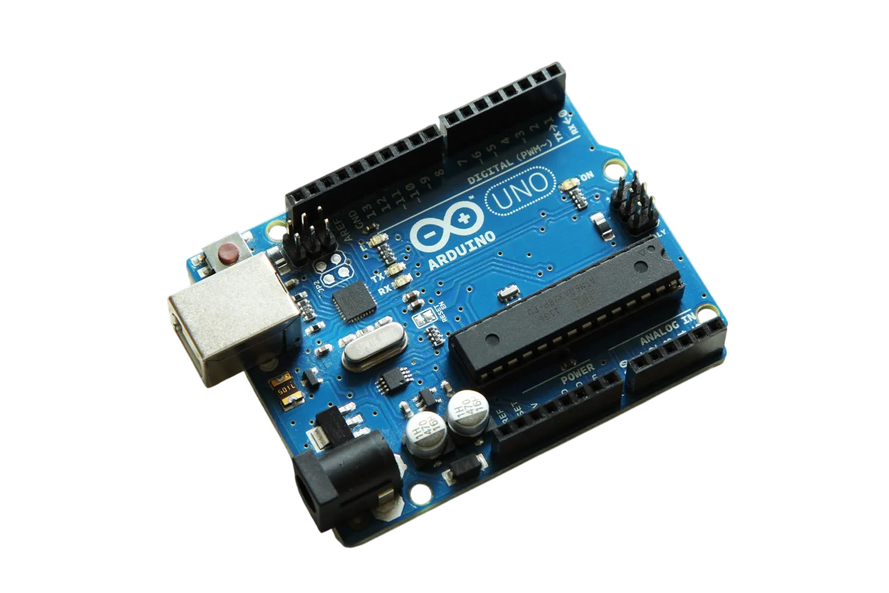
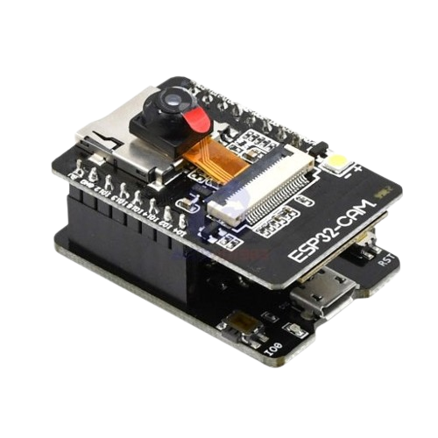
주요 사용 부품
Arduino UNO
ESP32-CAM
펌웨어 업로드 및 여러 하드웨어
부품 제어를 위해 사용
공부 상태 확인 AI 모델 구동 및
집중 상태 감지를 위해 사용

Slide 7



주요 사용 기술
Arduino IDE
TensorFlow
Teachable Machine
아두이노 보드에 펌웨어를 업로드하고 하드웨어 동작을 제어하기 위해 사용
공부 상태를 확인하는
AI 모델을 ESP32-CAM에서 구동하기 위해 사용
AI 모델을 학습시키기 위해 사용
해당 프로그램에서 학습 후 TensorFlow(.tflite) 파일로 변환

Slide 8
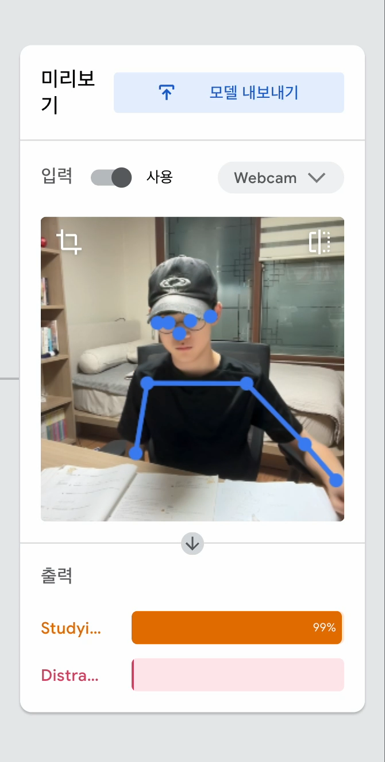
공부 상태 확인 AI
공부 상태를 확인하기 위해 AI 모델을 사용
동작 인식 기반으로, 책상에 손을 올리고 연필을 잡는 자세를 취하고, 고개가 밑으로 향할 때 집중으로 판단
Teachable Machine 프로그램으로 학습 후, TensorFlow 모델로 변환, ESP32-CAM에 업로드해서 사용
현재 AI 학습 완료

Slide 9
03
프로젝트 시연

Slide 10
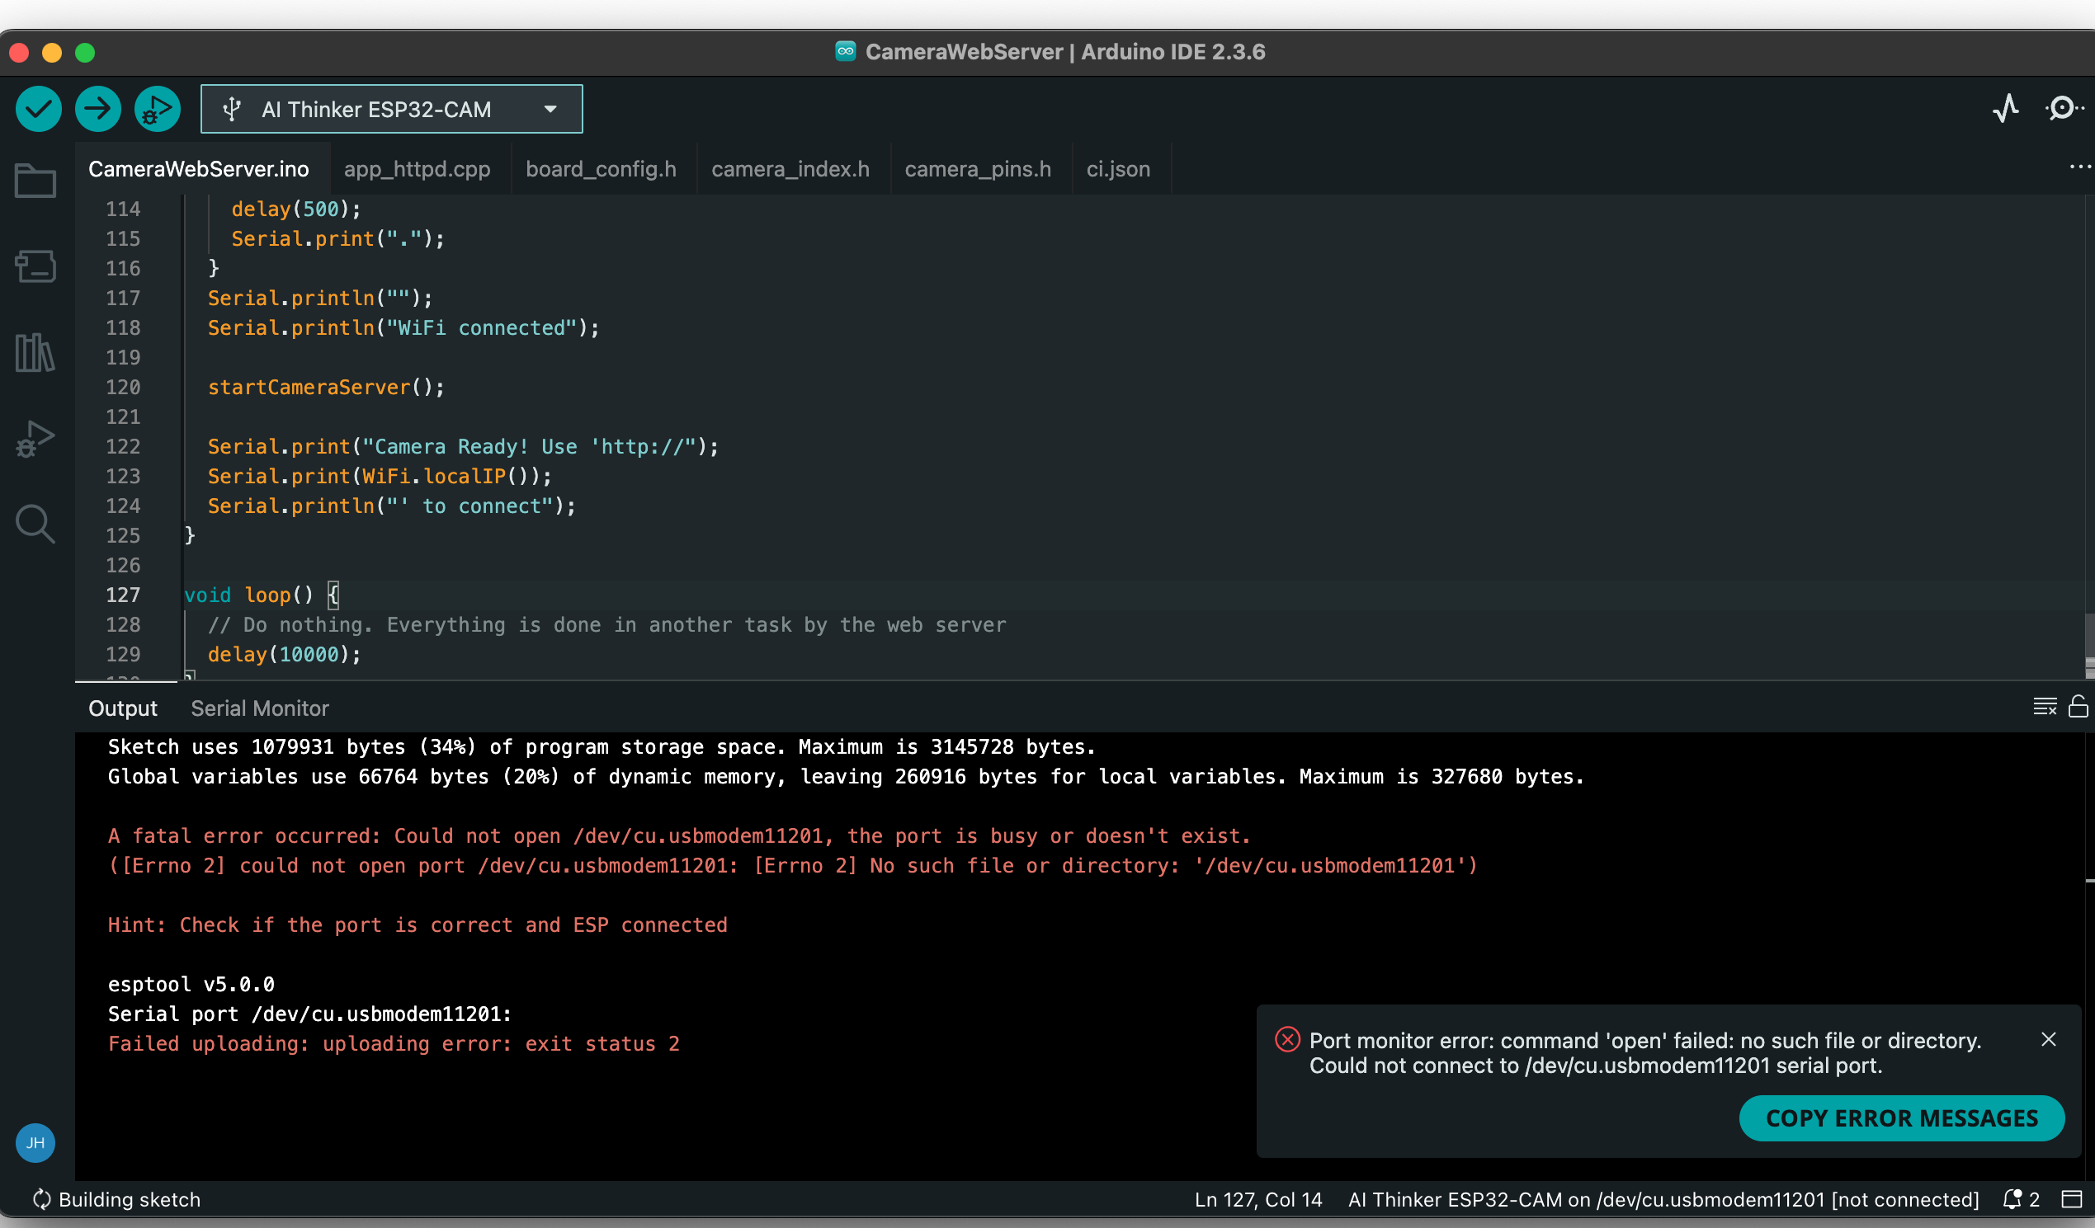
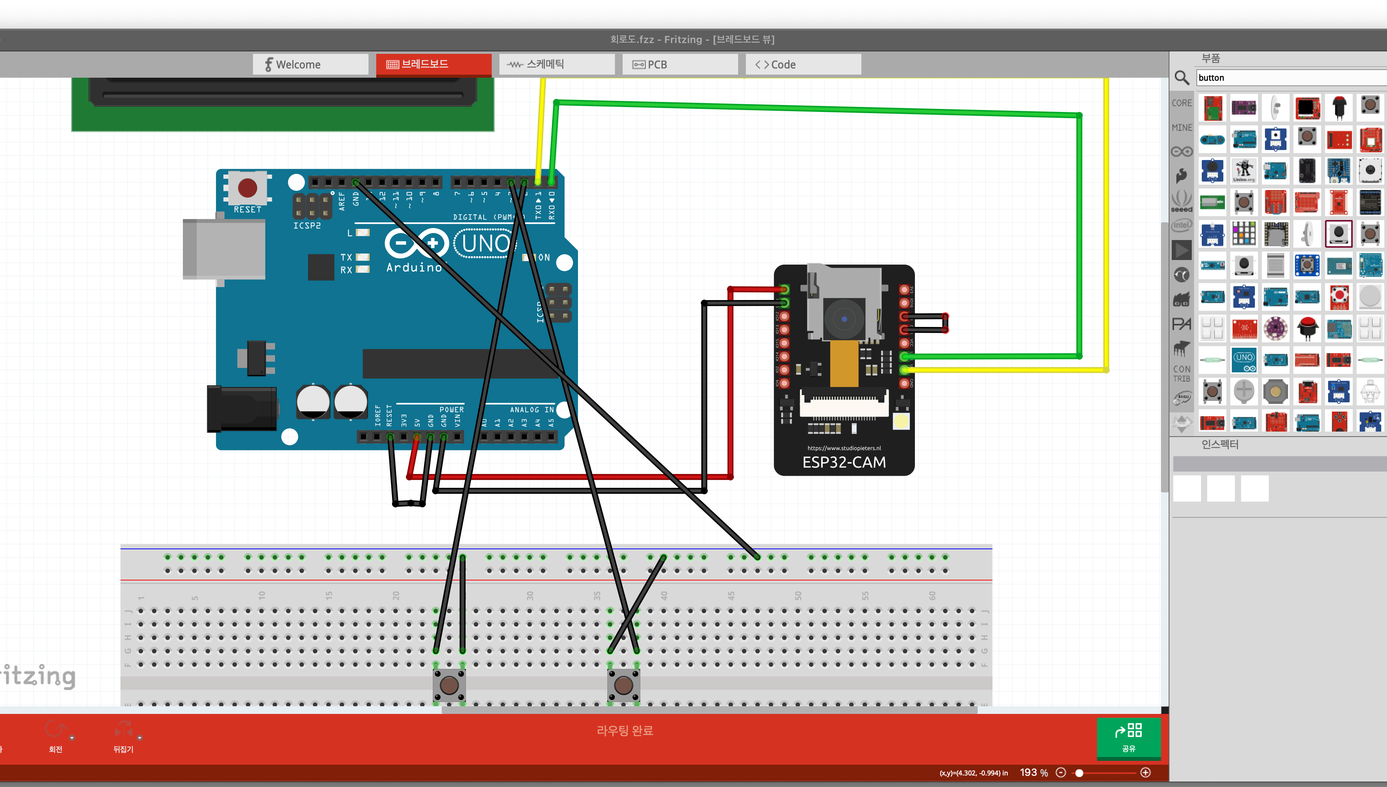
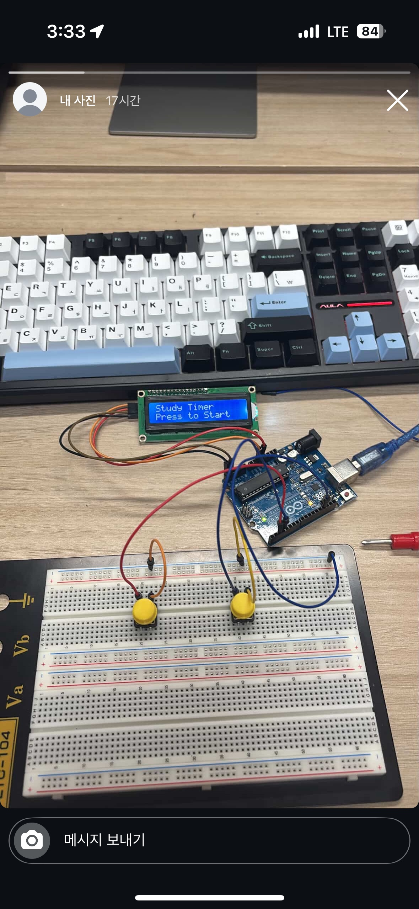
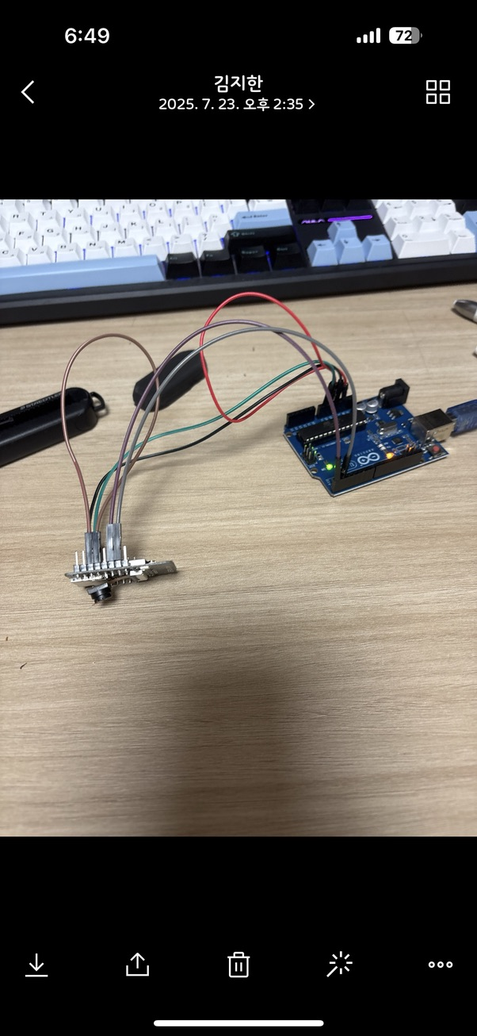
현재 상황
Arduino Uno + ESP32-CAM 코딩 중

Slide 11
감사합니다
Do you have any questions?
youremail@freepik.com
+34 654 321 432
yourwebsite.com
CREDITS: This presentation template was created by Slidesgo, and includes icons by Flaticon, and infographics & images by Freepik

Slide 12
04
프로젝트 복기

Slide 13

Contents of a portfolio
A portfolio is composed of three main elements:
Content: this includes the actual work you want to showcase and can be anything from writing samples to photographs or videos
Design: the design should reflect your personality and style while remaining professional. It should also make it easy to navigate the portfolio
Summary: a brief summary at the beginning of the portfolio will help provide an introduction to your work and give visitors a better understanding of yourself and what you have created

Slide 14
Things to include in your portfolio
Work samples
Skills
Professional narrative
Use the work samples for a practical overview of demonstrated capabilities and expertise. Each example offers insights into
various projects
Skills and qualifications are the credentials you have that show employers your experience and abilities in various areas that are related to your field
An overview of past project successes or other accomplishments as well as a summary of relevant knowledge and skills gained over the course of your career

Slide 15
02
Resume

Slide 16

John Doe
“I always strive for excellence. I believe in the power of collaboration, and I love to build meaningful relationships with clients throughout the creative process”
+34 654 321 432 | jane@freepik.com
Experience
Education
Now-20xx
Position A
Place A
20xx- 20xx
Studies 1
Competence
Competence
Competence
Describe your work tasks here
Describe your work tasks here
20xx-20xx
Position B
Place B
20xx- 20xx
Studies 2
Competence
Competence
Competence
Describe your work tasks here
Describe your work tasks here
20xx-20xx
Position C
Place C
20xx- 20xx
Studies 3
Competence
Competence
Competence
Describe your work tasks here
Describe your work tasks here

Slide 17
Cover letter
Welcome to my portfolio!
I'm [name], a highly creative and motivated individual, with a passion for [field of expertise]. My portfolio is filled with unique and inspiring content, which showcases my skills in the field.
Here you will find a lot of content that shows all my work. I strive for excellence in all that I do, and this portfolio serves as a testament to my capabilities and accomplishments.
Have a look around, get to know me better, and don't hesitate to reach out if you have any questions or would like to collaborate!
Sincerely,
Slidesgo
+91 651 736 904
charlie@slidesgo.com
Jane Doe
+91 620 421 838 | jane@freepik.com

Slide 18



Photo showcase
This photo showcase is a collection of stunning images, each capturing the essence of my work. Let them inspire you!

Slide 19


My best work
Here you will find a collection that reflects my dedication to delivering impactful and well-executed projects. Each piece embodies a commitment to excellence, blending skillful execution with a focus on detail

Slide 20

"Creativity is the key to unlocking your true potential"
1001010100101010
1010010010110111

Slide 21
Previous projects
Project 1
Project 2
“Explore the details of one of my previous projects, a testament to my ability to meet challenges head-on and deliver results. This undertaking reflects my approach to [industry/field] and highlights the diverse skills applied to ensure successful outcomes”
“In this showcase of past projects, delve into another example that underscores my versatility and commitment to excellence. From concept to completion, witness how I navigated complexities and contributed to the success of this [industry/field] initiative”

Slide 22
What people say about me
Employer 1
Employer 2
“I have been impressed by the quality, attention to detail and creative approach brought to every project made”
"This person's dedication and attention to detail significantly contributed to project success. Their creativity and ability to meet tight deadlines set them apart"
Employer 3
Employer 4
“This person has a strong technical understanding in order to develop successful strategies. Highly recommended for any kind of project or task”
"Working with this person has been valuable. Their strong work ethic and leadership qualities are instrumental in project success, combining a keen understanding of the bigger picture”

Slide 23
My skills and qualifications
Leadership
Problem-solving
Communications
“I possess leadership abilities that have been sharpened through past roles where I was responsible for the teams”
“My problem-solving capabilities have enabled me to solve difficult issues in the past, using creative and innovative solutions”
“With excellent verbal and written skills, I can effectively convey complex messages to a variety of audiences"
Organization
Technical skill
Interpersonal skill
“My proactivity allows me to plan ahead and prioritize tasks according to objectives and different deadlines"
“I am knowledgeable in several technical areas that support my ambition in my field"
“Teamwork is one of the essential part of my daily job, and I am sensitive towards different cultures"

Slide 24
200
The number of projects I have worked on so far

Slide 25
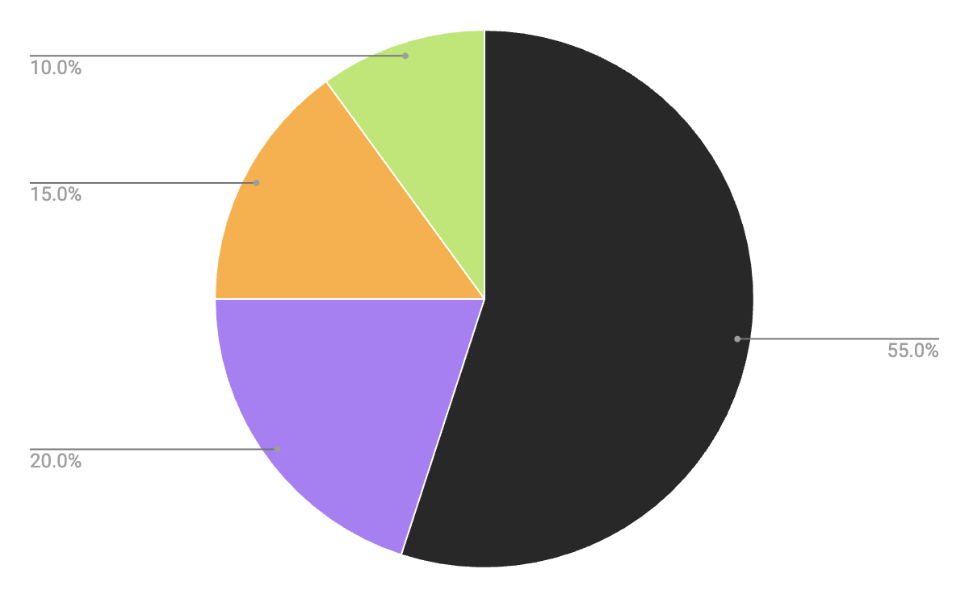
A chart of the areas I work in
Area 1
Describe the area here
Area 2
Describe the area here
Area 3
Describe the area here
Area 4
Follow the link in the graph to modify its data and then paste the new one here. For more info, click here
Describe the area here

Slide 26
Table
Project title | Skills | Date | Ref | Category
Project 1 | Describe the skills here | Jan 20XX | [Link or reference] | Write the category
Project 2 | Describe the skills here | Feb 20XX | [Link or reference] | Write the category
Project 3 | Describe the skills here | Mar 20XX | [Link or reference] | Write the category
Project 4 | Describe the skills here | Apr 20XX | [Link or reference] | Write the category
Project 5 | Describe the skills here | May 20XX | [Link or reference] | Write the category
Project 6 | Describe the skills here | Jun 20XX | [Link or reference] | Write the category

Slide 27
How did I achieve success?
Step 1
Step 2
Step 3
Step 4
Identifying objectives
Research and preparation
Developing strategies
Plans of action
Step 5
Step 6
Step 7
Step 8
Measuring progress
Continuous improvement
Analyzing outcomes
Focusing on the future

Slide 28
Roadmap of my future projects
1010010101001010
Initiative | Objective | Jan | Feb | Mar | Apr | May | Jun | Jul | Aug | Sep | Oct | Nov | Dec
Briefly describe the initiative 1 | Describe the goal you want to achieve during the initiative
Briefly describe the initiative 2 | Describe the goal you want to achieve during the initiative
Briefly describe the initiative 3 | Describe the goal you want to achieve during the initiative
Briefly describe the initiative 4 | Describe the goal you want to achieve during the initiative
Briefly describe the initiative 5 | Describe the goal you want to achieve during the initiative
Briefly describe the initiative 6 | Describe the goal you want to achieve during the initiative
1001010101010100

Slide 29
Thanks!
Do you have any questions?
youremail@freepik.com
+34 654 321 432
yourwebsite.com
Please keep this slide for attribution

Slide 30
Icon pack

Slide 31
Alternative resources
Here’s an assortment of alternative resources whose style fits that of this template:

Slide 32
Resources
Did you like the resources used in this template? Get them on these websites:
Photos
Front view smiley man holding coffee cup
Composition with html system for websites
Composition with html system for websites I
Html system for website concept
Html system for websites concept
Programming background with person working with codes on computer
Programming background with person working with codes on computer
Html and css collage concept with person
Icons
Icon Pack: Programming | Lineal

